Slide 1
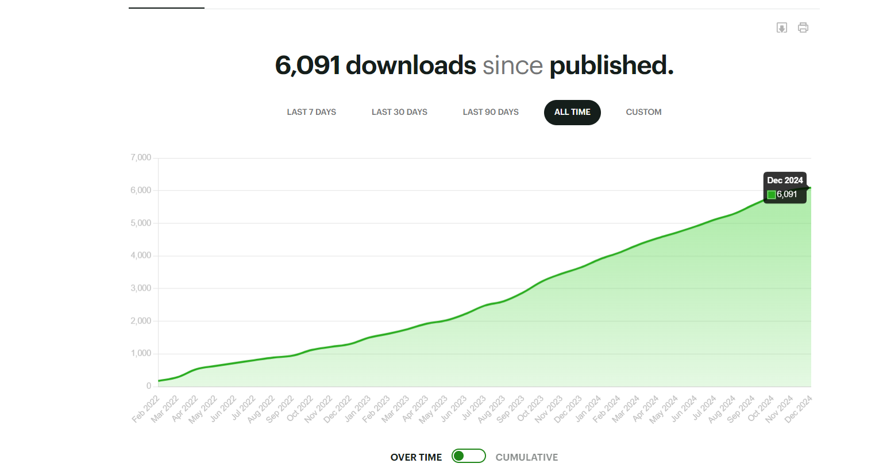

Slide 2
December
Season of Giving
Guests:
Caroline Lee Ruwet
Marketing Director
Access health
PODCAST
We continue our partnership with them and we highlighted their programs and enrollment fairs that continue through December and into January as well as their year-round locations for changes in life circumstances. They have our QR code in a one-sheet posted at the fairs.

Slide 3
December
Season of giving
Guests:
Lisa Tepper Bates
President and CEO of United Way of CT
PODCAST
We discussed the ALICE report and Alice is an acronym for Asset Limited, Income Constrained, Employed. We talked about the annual report and how people in CT are struggling to make ends meet, but that programs like CTPL help.

Slide 4
Buzzsprout is a favorite for podcasters. In August 2024, it had 120,571 active podcasts with 93,477,413 total downloads.

